Slide 1
Communication framework for vehicle
ad hoc network on freeways
K.L. Chiu and R.H. Hwang
Presented by: Ron Meiry 3011224283
Slava Ustinov 309930006

Slide 2
Introduction
Our article proposes a new scheme for vehicular communication over highways.
It’s an application-layer vehicular ad-hoc network (VANET) communication protocol.
This scheme proposes to enhance the conventional VANET schemes by dealing with some of the drawbacks of those protocols: high jitter delay and short transmission range, while adding new features such as emergency flood broadcasts and a car-fleet management system.

Slide 3
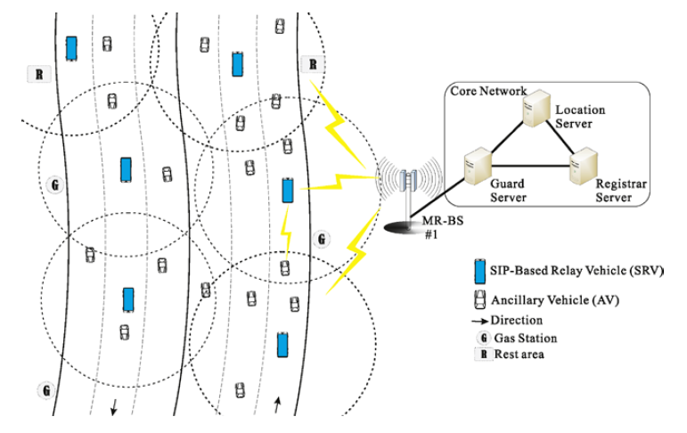
Architecture
Ancillary Vehicle (AV) – A regular vehicle that uses the network’s services.
SIP-based Relay Vehicle (SRV) – Relays all communication between the AVs and the infrastructure.
Base Station (BS) – Connects all SRVs to the infrastructure
Guard Server – Performs routing between servers and base stations.
Location Server – Logs the locations of vehicles over the network
Registrar Server – Responsible for authentication and authorization of all clients over the network

Slide 4
Simulation - Modules
AV
SRV
BS
On-board computer
SIP Proxy
WiMAX
Ethernet
UDP/IP
UDP/IP
WiMAX
WiMAX
Control
Guard
Location
Registrar
SIP Guard
SIP Location
SIP Registrar
UDP/IP
UDP/IP
UDP/IP
Ethernet
Ethernet
Ethernet

Slide 5
Module Overview
WiMAX
Implements S&W mechanism with ACKs and TimeOuts.
Each WiMAX channel has a priority queue, when FLOOD messages are prioritized.
Frame error probability is calculated relatively to the distance between the vehicles.
AV, SRV and Control_unit
All vehicle relocation along the road are handled by the Control_unit.
On a crash event (when the range between 2 vehicles is 5 meters or less), the vehicle at the rear breaks, reduces it’s speed to 60 kmh and sends a FLOOD message.
On reception of a FLOOD message, AVs and SRVs will react to it only if it’s originated location is relevant to their functionality.
A vehicle returns to normal speed (variable around 110 kmh) only after it hasn’t received a FLOOD message for over 2 seconds.
Guard Server
Receives all FLOOD messages across the road and filters the ones that already been handled.

Slide 6
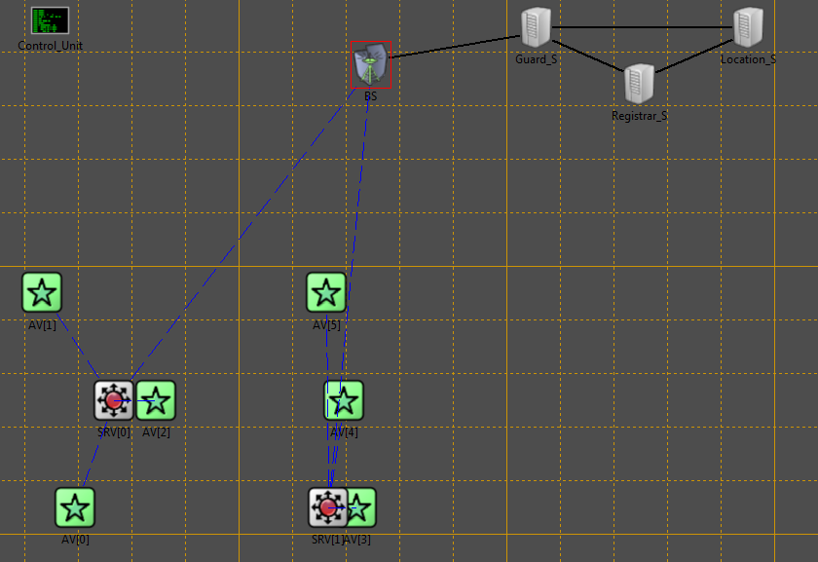
Simulation – Network
A snapshot of a simulation with 2 SRVs and 3 AVs per SRV
Our Control_unit module is responsible for all vehicle relocation on the road, thus it simulates movement along the road and crash events.

Slide 7
Simulation
Messages
Register – Sent only at the beginning of the simulation. Meant to register all vehicles, AVs and SRVs, to the network.
Register OK – A reply to a Register message. Sent by the Registrar server.
HELLO - Keep-alive messages. Sent by and AV to it’s SRV and by an SRV to it’s BS.
Control – Sent by all AVs and SRVs every 2 seconds. Done to relocate the vehicles along the road and simulate crash events.
ACK
FLOOD - Sent across the network on a crash event.
Assumptions
AVs are always in range of the SRV. If an AV slips out of range, we relocate it to opposite edge of the SRVs range limit.
SRV and the BS are always within range.
If a vehicle switches lanes, it can switch to the same lane and it can’t crash.

Slide 8
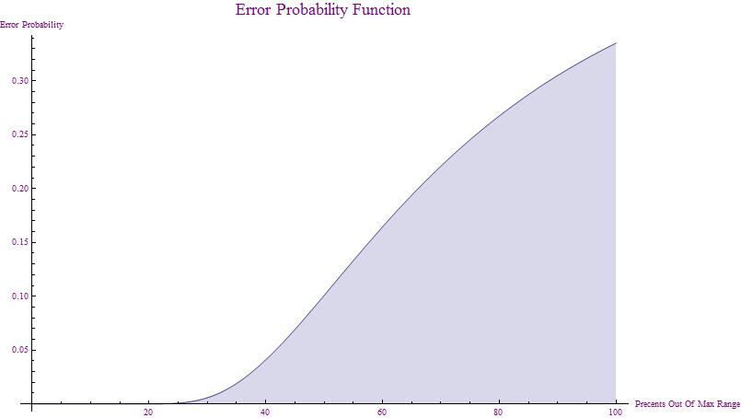
Simulation – Parameters
Road Length = 3000
Number of SRVs = 3
SRV range = 200
FLOOD duration = 1second
HELLO message interval = 0.5 second
Number of lanes = 3
Percentage of crazy drivers = 15%
Lane switch probability = 0.3
WiMAX buffer size = 50 frames
Simulation time = 100 seconds
Error probability function:
Y-axis – Error prob.
X-axis – Percentage out of max
range

Slide 9
Demonstration

Slide 10
Results
The instructions given were to gather results and compare them to results in the original article. However, it was mostly impossible - we could not simulate a big part of the parameters in the original article, and we were able to gather results to compare with only one of the graphs.
In addition, we decided to simulate and graph several other behavioral features of this scheme, with emphasis on the efficiency of the safety system (FLOOD messages).

Slide 11
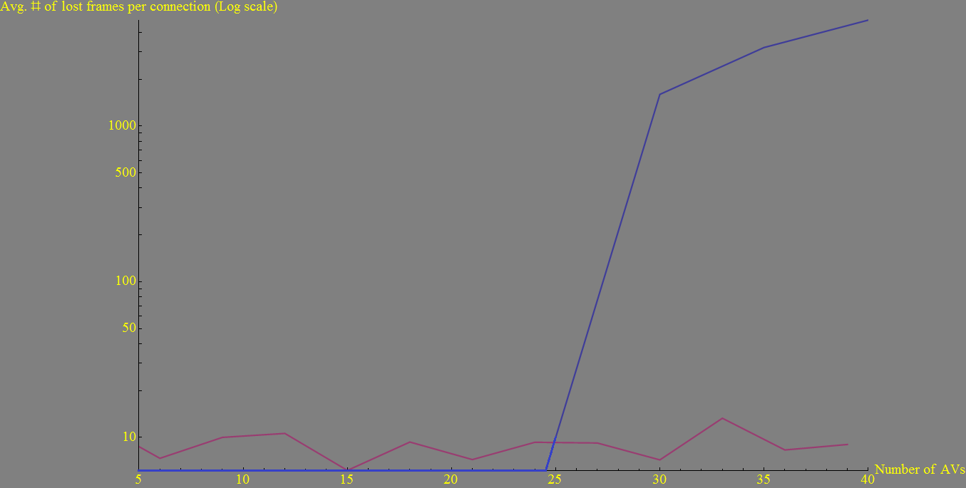
Average frame loss rate per AV (# of AVs)
Article graph
Our graph
As can be seen, out graph is fairly different form the article’s. The discrepancy comes from our implementation of the WiMAX protocol.
Our WiMAX is a simple S&W protocol which doesn’t really simulate an actual WiMAX protocol.
Furthermore, our error function (as shown before) probably doesn’t represent the actual error rate between two users.

Slide 12
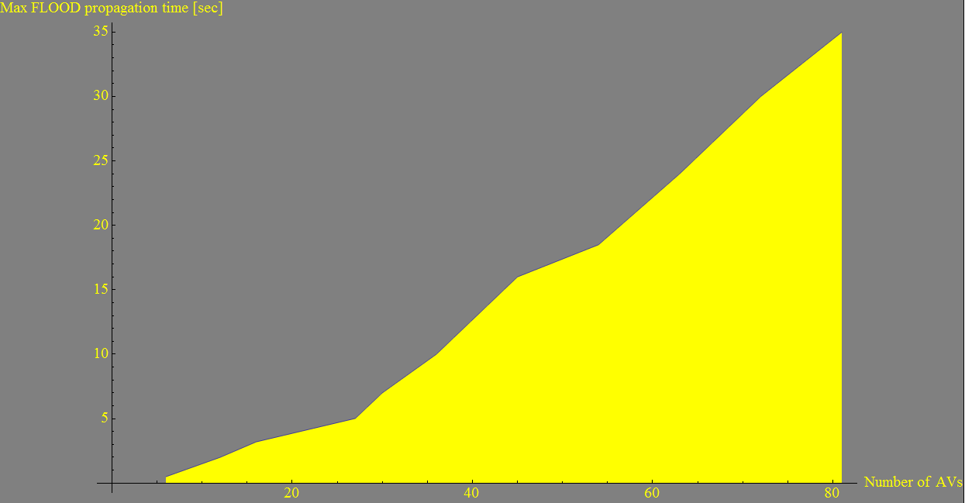
Max FLOOD prop. time (# of AVs)
The maximum time of a FLOOD message propagation across the network is highly affected by the WiMAX timeout value (which we’ve set to 0.5 seconds) and the amount of floods across the network. The bottleneck in this case is the BS, which queues up all flood messages and sends them one by one across the network.

Slide 13
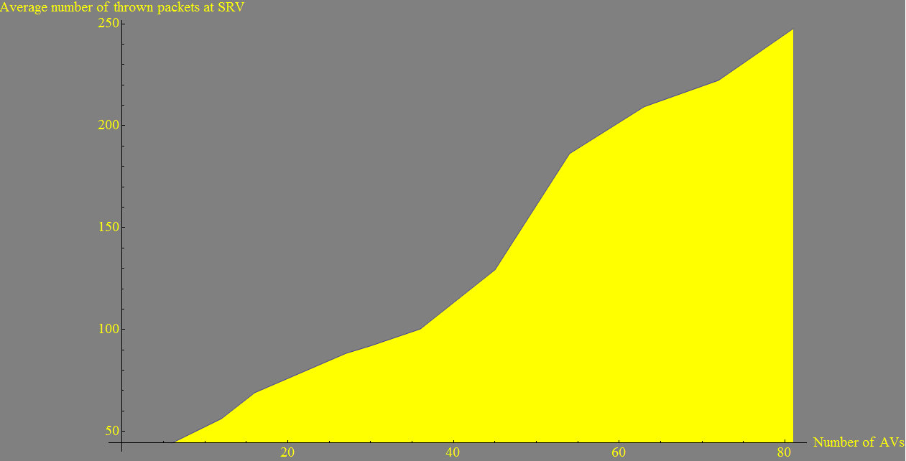
Average # of thrown packets at SRV (# of AVs)
Though this graph looks at the average amount of thrown packets across the network, most of the packets are thrown by the SRVs at the rear end of the road, since they’re affected by all FLOOD messages arriving from vehicles in front of them, causing them to transmit that FLOOD themselves.

Slide 14
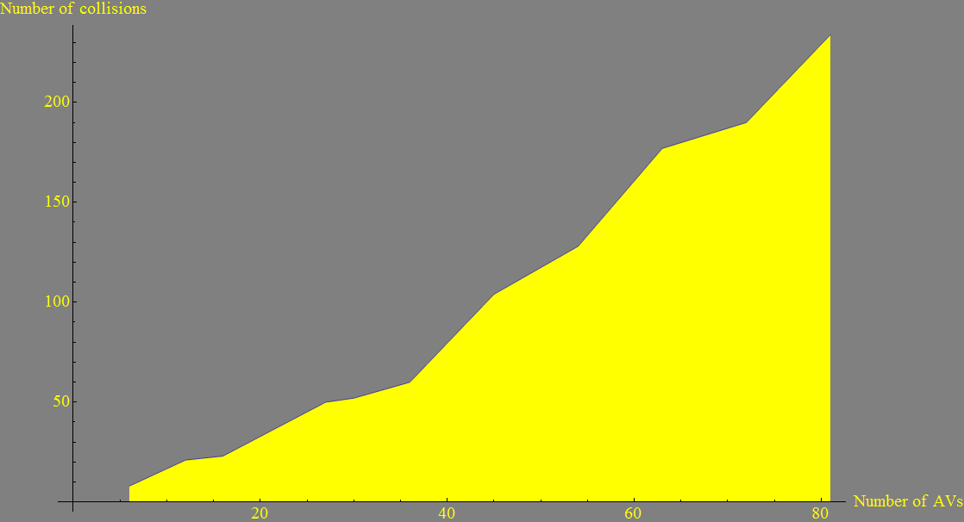
Number of collisions (# of AVs)
As expected, the number of collisions rises, somewhat linearly, as a function of the number of AVs per SRV.

